Slide 1

Beginning iOS Development MVC in iOS
Daniel Norton
8/17/2011 1:00 PM

Slide 2
Agenda
Candy Store Overview
Basic View Controller
Modal View Controller
Tab Bar View Controller
Navigation Controller
Table View Controller
Custom Cells
Row Animation
What’s new in iOS5
Additional Resources

Slide 3

github: danielnorton blog: framewreck.net twitter: @daniel_norton
github.com/danielnorton/CandyStore-app
github.com/danielnorton/candystore-server
Candy Store
The Demo App
Notes:
This is my third year in a row to teach iOS development sessions at devLink. Usually, my presentations follow a cadence of introducing a new concept or a new class and then building a quick demo of how to use that particular technology in isolation. This year, I thought I might follow a little different approach. I have built a fully functional app called Candy Store that I will use in both of my sessions as the basis for the topics we are going to cover. The idea being that we are not only going to discuss how to use a particular technology, but also how that technology fits into the big picture of an app. So we will see not only the “how” but also the “why” and “when”.
You can find the source to Candy Store out on github from the two links listed here. I have also been writing about my experience in building Candy Store on my blog. I have not yet written all I wish to write about Candy Store, so you can follow the RSS there or keep up with me on twitter. So, there’s what all the links are for.
Let’s have a quick look at the completed Candy Store app.

Slide 4

Candy Store
App
Candy Store
Server
CouchDB
UIKit
CoreData
App Store
StoreKit
Candy Store Architecture

Slide 5

A few caveats ...
STOREKIT
Y U NO WORK IN SIMULATOR?

Slide 6

Basic View Controller

Slide 7
AboutViewController
UIViewController
NSObject
- (void)dealloc
- (void)viewDidUnload
- (void)viewDidLoad
UIView
UILabel
UILabel
UIImageView
About View Controller decomposed

Slide 8


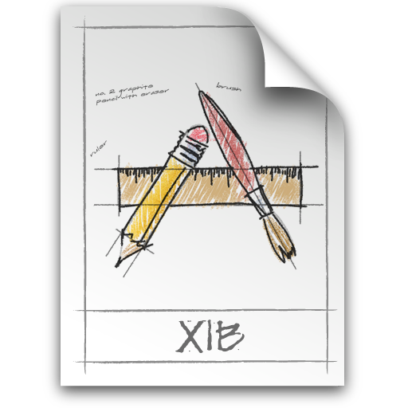
CandyStoreAppDelegate.h
CandyStoreAppDelegate.m
MainWindow.xib
AboutViewController.h
AboutViewController.m
AboutViewController.xib
Where does this happen in code?

Slide 9
Code
Basic View Controller
Change view properties at run-time
Set up view properties in Interface Builder
Wire up a view controller to the app in Interface Builder
Notes:
git reset --hard HEAD
git checkout 2011_01_AboutViewController
============================================
View AboutViewController.h
View AboutViewController.m
== AboutViewController.xib ==
-- UIImage
--- frame: x 100, y 307, w 120, h 120
--- image: aboutLogo.png
-- UILabel
--- frame: x 20, y 425, w 280, h 27
--- text: Use StoreKit
--- Font: Helvetica 17.0f
--- Text Color: Black Color
--- Shadow: Light Gray Color
--- Shadow offset: 0, -1
--- IBOutlet: File's Owner -> storeKitLabel
View CandyStoreAppDelegate.h
View CandyStoreAppDelegate.m
== MainWindow.xib ==
--- Add About View Controller
--- IBOutlet: CandyStore App Delegate -> viewController

Slide 10
Modal View Controller

Slide 11
Code
Modal View Controller
Create a view controller from within another view controller
Respond to an IBAction
Present a view controller modally
Notes:
git reset --hard HEAD
git checkout 2011_02_ModalViewController
============================================
CandyJarViewController.m
-- uncomment IBAction code
CandyJarViewController.xib
-- add curl UIBarButtonItem
-- IBAction -> didTapAboutButton:

Slide 12
Tab Bar Controller and Navigation View Controller

Slide 13
UIViewController
UITabBarItem
UITabBarController
UIViewController
UITabBarItem
UIViewController
UITabBarItem
AboutViewController
UIViewController
NSObject
Basic Tab Bar Controller
- (void)dealloc
- (void)viewDidUnload
- (void)viewDidLoad
UIView
UILabel
UILabel
UIImageView

Slide 14
MainWindow.xib
CandyJarViewController
UITabBarController
UINavigationViewController
CandyShopViewController
UINavigationViewController
CandyExchangeViewController
AboutViewController
UIViewController
NSObject
Candy Shop Tab Bar Controller
- (void)dealloc
- (void)viewDidUnload
- (void)viewDidLoad
UIView
UILabel
UILabel
UIImageView
Notes:
You see that Candy Store combines tab bar controllers and navigation view controllers. So, let’s also have a look at the concept of navigation view controllers

Slide 15
MainWindow.xib
CandyStore
AppDelegate
CandyJarViewController
UIBarButtonItem
UITabBarController
UINavigationViewController
CandyShopViewController
UINavigationViewController
CandyExchangeViewController
AboutViewController
UIViewController
NSObject
Candy Shop Tab Bar Controller
- (void)dealloc
- (void)viewDidUnload
- (void)viewDidLoad
UIView
UILabel
UILabel
UIImageView
Notes:
Also note that CandyStoreAppDelegate is also a UITabBarControllerDelegate

Slide 16
UINavigationViewController
UINavigationBar
UIViewController
UINavigationItem
UIBarButtonItem
UIBarButtonItem
AboutViewController
UIViewController
NSObject
Basic Navigation View Controller
- (void)dealloc
- (void)viewDidUnload
- (void)viewDidLoad
UIView
UILabel
UILabel
UIImageView

Slide 17
Code
Tab Bar Controller and Navigation View Controller
Wire-up a tab bar controller and a navigation controller in Interface Builder
Investigate IBOutlets
Update a tab bar item in code
See pushing view controllers on the navigation stack
Notes:
git reset --hard HEAD
git checkout 2011_03_TabBarController
============================================
View MainWindow.xib
-- Show tab bar items
-- show navigation stack
-- show UINavigationBar tint
-- show IBAction from refresh button
-- show the UITabBarControllerDelegate IBOutlet
Edit MainWindow.xib
-- Add a Navigation View Controller to the tab bar controllers list
-- Copy and paste the tint color from another navigation bar
-- Set the view controller class and xib to: CandyExchangeViewController
-- IBOutlet: app delegate > candyExchangeViewController
-- Set the navigation item title to: Candy Exchange
-- add a refresh button to the navigation item
-- add IBAction from refresh button to app delegate
-- Set tab item title to: Candy Exchange
-- Set tab image to: exchangeTab.png
View CandyStoreAppDelegate.h
-- see all the IBOutlets
-- see the UITabBarControllerDelegate methods
View CandyStoreAppDelegate.m
-- see updateJarTabImage (at bottom)
View CandyShopViewController.m
-- see didSelectRowAtIndexPath:
--- pushing a new view controller onto the navigation stack

Slide 18
A few extra thoughts on Navigation View Controllers
[self.navigationController popViewControllerAnimated:YES];
[self.navigationController popToRootViewControllerAnimated:YES];

Slide 19
A few extra thoughts on Tab Bar Controllers
[myJarTabBarItem setBadgeValue:@"5"];
- (BOOL)tabBarController:(UITabBarController *)aTabBarController shouldSelectViewController:(UIViewController *)viewController;

Slide 20
Table View Controllers

Slide 21
UIViewController
UITableViewController
UIView
UITableView
UIView *theView = self.view;
UITableView *theView = self.tableView;
UITableView *sameView = (UITableView *)self.view;
Basic Table View Controller

Slide 22
UITableViewController
<<UITableViewDataSource>>
UITableView
<<UITableViewDelegate>>
Basic Table View Controller

Slide 23
<<UITableViewDataSource>>
- (NSInteger)numberOfSectionsInTableView:(UITableView *)tableView;
- (NSInteger)tableView:(UITableView *)tableView numberOfRowsInSection:(NSInteger)section;
- (UITableViewCell *)tableView:(UITableView *)tableView
cellForRowAtIndexPath:(NSIndexPath *)indexPath;
- (NSString *)tableView:(UITableView *)tableView titleForHeaderInSection:(NSInteger)section;
<<UITableViewDelegate>>
- (CGFloat)tableView:(UITableView *)tableView heightForRowAtIndexPath:(NSIndexPath *)indexPath;
- (void)tableView:(UITableView *)tableView willDisplayCell:(UITableViewCell *)cell forRowAtIndexPath:(NSIndexPath *)indexPath;
- (void)tableView:(UITableView *)tableView didSelectRowAtIndexPath:(NSIndexPath *)indexPath;
Basic Table View Controller

Slide 24
NSIndexPath
@property(nonatomic,readonly) NSUInteger section;
@property(nonatomic,readonly) NSUInteger row;
UITableViewCell
@property(nonatomic,readonly,retain) UIImageView *imageView;
@property(nonatomic,readonly,retain) UILabel *textLabel;
@property(nonatomic,readonly,retain) UILabel *detailTextLabel; @property(nonatomic,readonly,retain) UIView *contentView;
@property(nonatomic) UITableViewCellAccessoryType accessoryType;
@property(nonatomic,retain) UIView *accessoryView;
Basic Table View Cell

Slide 25
UITableViewCell
ExchangeListItemCell
@property (nonatomic, retain) IBOutlet UILabel *titleLabel;
@property (nonatomic, retain) IBOutlet UILabel *quantityLabel;
@property (nonatomic, retain) IBOutlet UIImageView *iconView;
Custom Table View Cell

Slide 26
UITableViewController
RefreshingTableViewController
CandyShopViewController
CandyExchangeViewController
Candy Store Table View Controllers

Slide 27
Code
Table View Controllers
Table view data source and delegate implementation
Basic cell creation
Custom cell creation
Notes:
git reset --hard HEAD
git checkout 2011_04_TableViewController
============================================
Show RefreshingTableViewController.h
-- inheritance from UITableViewController
Show RefreshingTableViewController.m
-- UITableViewDataSource implementations
-- refreshingCellForTableView: and configureRefreshingCell: as example of basic cell construction
-- reloadVisibleCells
Show CandyShopViewController.h
-- ShopListItemCell custom cell
Show CandyShopViewController.m
-- Inheritance from RefreshingTableViewController
-- UITableViewDataSource implementation
--- ShopListItemCell custom cell
-- UITableViewDelegate implementation
Show ShopListItemCell.xib
Show ShopListItemCell.h
Show ShopListItemCell.m

Slide 28
Row Animations
[tableView beginUpdates];
[tableView insertSections:top withRowAnimation:UITableViewRowAnimationFade];
[tableView insertRowsAtIndexPaths:refreshRows withRowAnimation:UITableViewRowAnimationFade];
[tableView deleteRowsAtIndexPaths:indexPaths withRowAnimation:UITableViewRowAnimationFade];
[tableView deleteSections:removeSections withRowAnimation:UITableViewRowAnimationFade];
[tableView reloadSections:top withRowAnimation:UITableViewRowAnimationNone];
[tableView endUpdates];
Before and after must jive with:
- (NSInteger)numberOfSectionsInTableView:(UITableView *)tableView;
- (NSInteger)tableView:(UITableView *)tableView numberOfRowsInSection:(NSInteger)section;
Notes:
RefreshingTableViewController
beginRefreshing

Slide 29
Code
Row Animations
Remove sections and rows
Add sections and rows
Notes:
git reset --hard HEAD
git checkout 2011_04_TableViewController
============================================
Show RefreshingTableViewController.m
-- beginRefreshing
-- completeRefreshing

Slide 30
A few extra thoughts on Table View Controllers
The view controller does not have to inherit from UITableViewController. All it has to do is implement UITableViewDelegate and UITableViewDataSource
Performance is a key consideration
Notes:
See CandyJarViewController

Slide 31
What’s New in iOS5
How are the topics we discussed today impacted by new features and technologies in iOS5?
Storyboards
Automatic Reference Counting
Static Content UITableViewController nibs
iCloud?

Slide 32
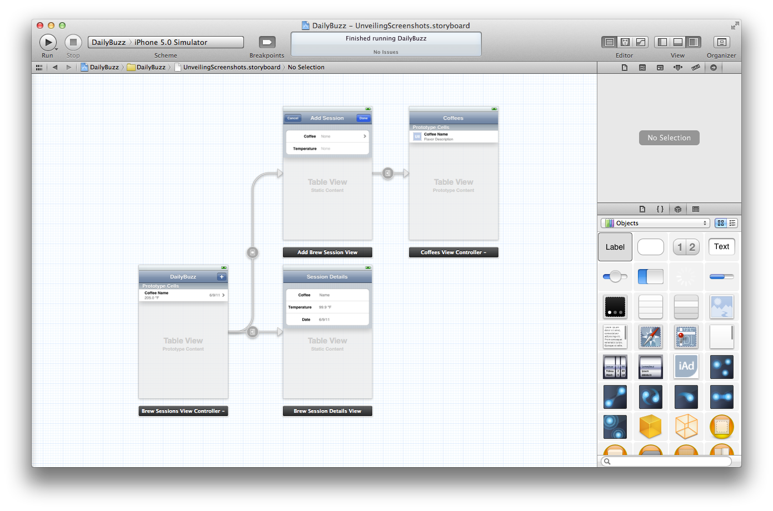
iOS 5 Storyboarding

Slide 33
Additional Resources
iOS Developer Library
iOS Development Guide
iOS Application Programming Guide
iOS Human Interface Guidelines
View Controller Programming Guide for iOS
Table View Programming Guide for iOS
Coding Guidelines for Cocoa
What’s New in iOS

Slide 34
Additional Resources
WWDC 2011 Videos
What’s New in Cocoa Touch
Introducing Interface Builder Storyboarding
Using Interface Builder in Xcode 4

Slide 35
Review
Candy Store Overview
Basic View Controller
Modal View Controller
Tab Bar View Controller
Navigation Controller
Table View Controller
Custom Cells
Row Animation
What’s new in iOS5
Additional Resources

Slide 36
github: danielnorton blog: framewreck.net twitter: @daniel_norton
github.com/danielnorton/CandyStore-app
github.com/danielnorton/candystore-server
Candy Store
Thanks, guys! Enjoy the rest of devLink 2011!

